Slide 1
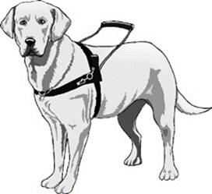
Service Animals, the Americans with Disabilities Act, and Public Transportation
September 4, 2020
Presenters:
Donna DeStefano, Tennessee Disability Coalition
Brian Keller, Disability Rights Tennessee
Stacie Price, Disability Rights Tennessee

Slide 2
The Americans with Disabilities Act (ADA) Title II
applies to State and local government entities
protects qualified individuals with disabilities from discrimination on the basis of disability
the prohibition on discrimination applies to all activities of State and local governments

Slide 3
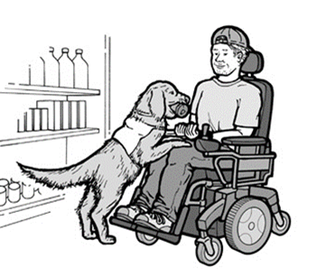
Service Animals ADA Definition, Title II
Service animals are defined as
dogs that are individually trained to do work
or perform tasks for people with disabilities.
There is also a separate provision about miniature horses.
NOTE: Dogs whose sole function is to provide comfort or emotional support do not qualify as service animals under the ADA.

Slide 4
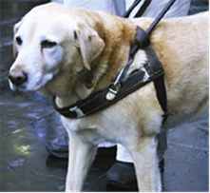
Service Animals Department of Transportation ADA Part One Different from Title II Definition of Service Animal
Service animal is defined as
any guide dog, signal dog, or other animal
individually trained to work or perform tasks
for an individual with a disability…

Slide 5
Service Animals Department of Transportation ADA Part Two
…including, but not limited to,
guiding individuals with impaired vision,
alerting individuals with impaired hearing to intruders or sounds,
providing minimal protection or rescue work,
pulling a wheelchair, or fetching dropped items”

Slide 6
Service Animals
Service animals are working animals, not pets.
Dogs whose sole function is to provide comfort or emotional support do not qualify as service animals under the ADA.
The work or task a dog has been trained to provide must be directly related to the person’s disability.

Slide 7
Caution!
Members of the public may find that some service animals may no
longer be considered service animals once they leave a public
transportation system.
For example, a cat trained to retrieve items for a person who uses a wheelchair for mobility may be a service animal on public transportation but would not be a service animal in a state government building.

Slide 8
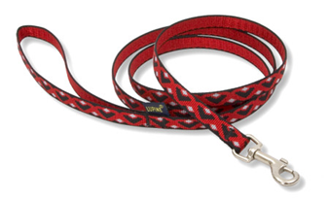
Under Handler’s Control
Under the ADA, service animals must be
harnessed, leashed, or tethered,
unless the individual’s disability prevents using these devices
or these devices interfere with the service animal's safe, effective performance of tasks.
Otherwise, the individual must maintain control of the animal through voice, signal, or other effective controls.

Slide 9
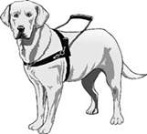
Service Animals
Under the ADA,
State and local governments, businesses,
and nonprofit organizations that serve the public
generally must allow service animals
to accompany people with disabilities
in all areas of the facility
where the public is allowed to go.

Slide 10
Inquiries, Exclusions, Charges, and Other Specific Rules Related to Service Animals Part 1
When it is not obvious what service an animal provides, only limited inquiries are allowed.
Staff may ask two questions:
is the dog a service animal required because of a disability, and
what work or task has the dog been trained to perform. Staff cannot ask about the person’s disability, require medical documentation, require a special identification card or training documentation for the dog, or ask that the dog demonstrate its ability to perform the work or task.

Slide 11
Inquiries, Exclusions, Charges, and Other Specific Rules Related to Service Animals Part 2
Allergies and fear of dogs are not valid reasons for denying access or refusing service to people using service animals.
A person with a disability cannot be asked to remove his service animal from the premises unless:
the dog is out of control and the handler does not take effective action to control it or
the dog is not housebroken.

Slide 12
Inquiries, Exclusions, Charges, and Other Specific Rules Related to Service Animals Part 3
People with disabilities who use service animals cannot be isolated from other patrons, treated less favorably than other patrons, or charged fees that are not charged to other patrons without animals.
If a business requires a deposit or fee to be paid by patrons with pets, it must waive the charge for service animals.
Staff are not required to provide care for or supervision of a service animal.

Slide 13
Relationship of ADA to Other Laws
The Fair Housing Act covers service animal provisions for residential housing situations
The Air Carrier Access Act covers service animal provisions for airline travel.
NOTE: The definition of a service animal under each of these laws is different from the definition under the ADA.

Slide 14
Federal Authority/Enforcement
Title II -- Regulated and enforced by the U.S. Department of Justice, Civil Rights Division
Public Transportation - Federal Transit Administration (FTA) Office of Civil Rights

Slide 15
State Laws Vary
Some states laws make it illegal to falsely claim that an animal is a service animal or falsely claim that you are entitled to be accompanied by a service animal.
Most violations are usually a misdemeanor.
Penalties vary by state for violating these laws.

Slide 16
Recent State Law – Missouri July 2020
Updates service and assistance animal legislation
Misrepresentation of a service dog or assistance animal includes but is not limited to knowingly:
creating false documents
providing false documents to another person
misrepresenting facts to a health care provider to obtain documentation
Class C misdemeanor and responsible for any actual damages incurred during the interaction

Slide 17
Proposed Legislation in Tennessee
Tennessee does not have any laws regarding the misrepresentation of a service animal in ADA-covered areas, including public transportation
Proposed 2020 legislation that would make it illegal to falsely claim an animal is a service animal in places of public accommodation has been put on hold

Slide 18
Future?

Slide 19
Resources to Share
Service Animals
https://www.ada.gov/service_animals_2010.htm
Frequently Asked Questions about Service Animals and the ADA
https://www.ada.gov/regs2010/service_animal_qa.html
United States Department of Transportation -- Accessibility
https://www.transportation.gov/civil-rights/civil-rights-awareness-enforcement/accessibility
Service Animal Resource Hub
https://adata.org/service-animal-resource-hub
This is a partial list; a full list will be sent as follow-up to all participants

