Slide 1
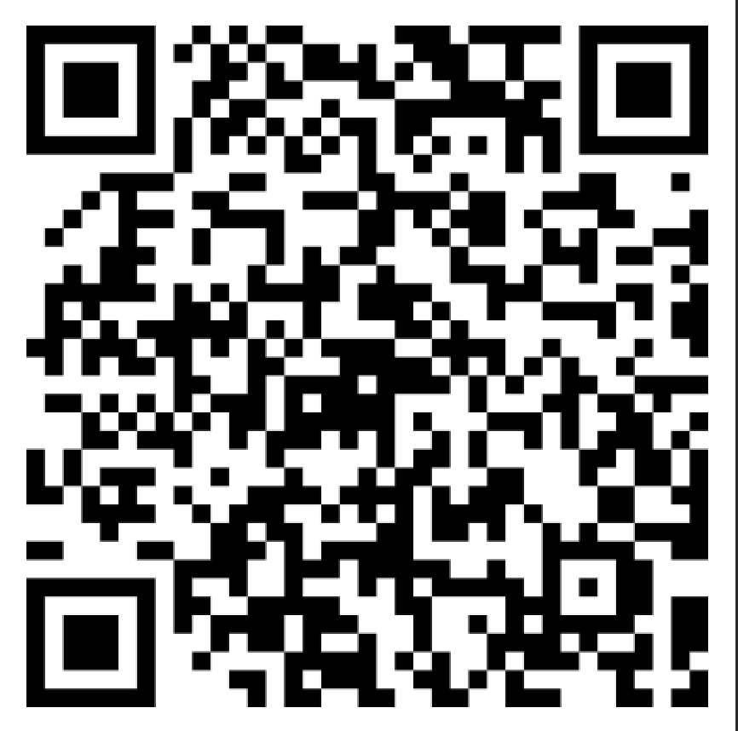
The End of SPED?
Text TEAMWORK to 72690 to stay up to date on special education in Tennessee
Sign up for policy updates at tndisability.org
Stay engaged in TDC advocacy, how you can be involved LINK or scan →

Slide 2
Agenda - 30 minutes presentation/30 minutes discussion
Here’s what’s happening - what we know, what we don’t, what we can speculate upon
Where does the money come from and where does it go?
And what are “strings”?
Quick and dirty background on IDEA
Here’s our advocacy plan
What you can do now
Short term/long term
Questions and discussion

Slide 3
What we know:
On Monday, September 25th, Speakers Cameron Sexton and Randy McNally announced the creation of a “Joint Working Group” to study the feasibility and impact of refusing federal funding from the Department of Education
The group is tasked with studying the idea and making a recommendation for how to reject federal funds
Members of the General Assembly have generally expressed support for idea of the working group (but not necessarily funding refusal)
Governor Lee has similarly expressed support for the working group, but has so far distanced himself a bit from its outcome (wait and see)
Members of the General Assembly (particularly Speaker Sexton) have cited “burdensome” regulations as the reason he is commissioning the working group
Sexton has been vague/unspecific about which regulations he objects to, but has alluded to testing and reporting requirements, school lunch rules and federal influence on curriculum choices

Slide 4
What we know (2):
We know the composition of the working group, which features 10 members of the General Assembly, including 8 Republicans and 2 Democrats
Senate: Sen. Jon Lundberg (co-chair), Sen. Joey Hensley, Sen. Raumesh Akbari, Sen. Bill Powers, Sen. Dawn White
House: Rep. Debra Moody (co-chair), Rep. Ronnie Glynn, Rep. John Ragan, Rep. Timothy Hill, Rep. William Slater
The Joint Working Group began their activities on November 6th, and will meet 7 times over 5 days
Last spring, when Speaker Sexton first floated the idea, he commissioned a report that laid out federal funding sources, destinations and obligations

Slide 5
What we know (3)
Trends in the first week:
Despite slowing revenue and a potential budget deficit, refusal is financially feasible for the state
District leaders are unenthusiastic about refusing funds
There is an odd concern about food waste
There are many questions that just cannot be answered in this forum
Some members of the panel are frustrated with the “tone” and focus of the conversation thus far
“What ‘good’ do the funds actually convey?”
It’s quiet so far

Slide 6
What we can speculate upon:
We do not know the outcome of the work yet, but we can speculate:
It is very likely that they make their recommendations before the beginning of the 2024 General Assembly session in January
It is also very likely that the working group charts a path toward refusing all $1.89 billion in federal DOE funds currently provided to Tennessee (recommends refusing funds)
It is possible (leaning toward likely) that Speaker Sexton will propose and attempt to pass legislation that refuses federal funding
It is difficult to anticipate the substance of the bill (what happens to special ed), but it is most likely that it leaves much of the “details” to rulemaking by the State Board of Education
We can speculate about Sexton’s commitment to the idea (is it a stunt or does he really mean it?)
We as advocates will very likely have to spend significant amounts of time, resources and energy in addressing the working group’s proposal

Slide 7
What we don’t know:
What proposed funding refusal legislation might look like (the details)
The degree of support in the House, Senate and Governor’s office
The timelines (when legislation would be introduced/heard, how long the refusal process could take, etc.)
The expectations of schools in implementing changes
The scope and extent of support and/or opposition from all interested parties
Short, incomplete list: disability groups, immigrant rights group, education rights groups, religious entities, business world, chambers of commerce, superintendents association, teachers unions, general public at large, etc.
How the federal government might respond (we got a hint this week)

Slide 8
What we can do right now
We have a plan/strategy, and we hope you will hear us out
Stay informed!
tndisability.org news and resource center
Watch the proceedings on the General Assembly website
https://wapp.capitol.tn.gov/apps/livevideo/
Reach out to your local legislators - ask them
Stay resolved - proponents of this potential legislation are purposefully drawing out the proceedings to make it difficult to stay engaged
This is a long-term fight and it will have different phases of engagement and advocacy
We may not know the outcome any time soon
No matter what, this is a red line
I don’t see a compromise on a policy such as this

Slide 9
Context - federalism overview
When the federal government provides funding to states (and other entities), those recipients must follow some rules
In this case, here are some of the rules the state must follow:
It must provide all 6 tenets of IDEA (IEP’s, evaluation, LRE, FAPE, parent/teacher involvement and due process/procedural safeguards), and is subject to monitoring and oversight
It must not violate the Civil Rights Act (discriminate against protected classes)
It must participate in national testing (NAEP)
Note - states have lots of flexibility here
It must report certain data to the feds (performance of protected classes, discipline data, achievement data, ARP data, delineated data, spending, etc.)
This is what refusal advocates mean when they say “strings” in reference to federal funding

Slide 10
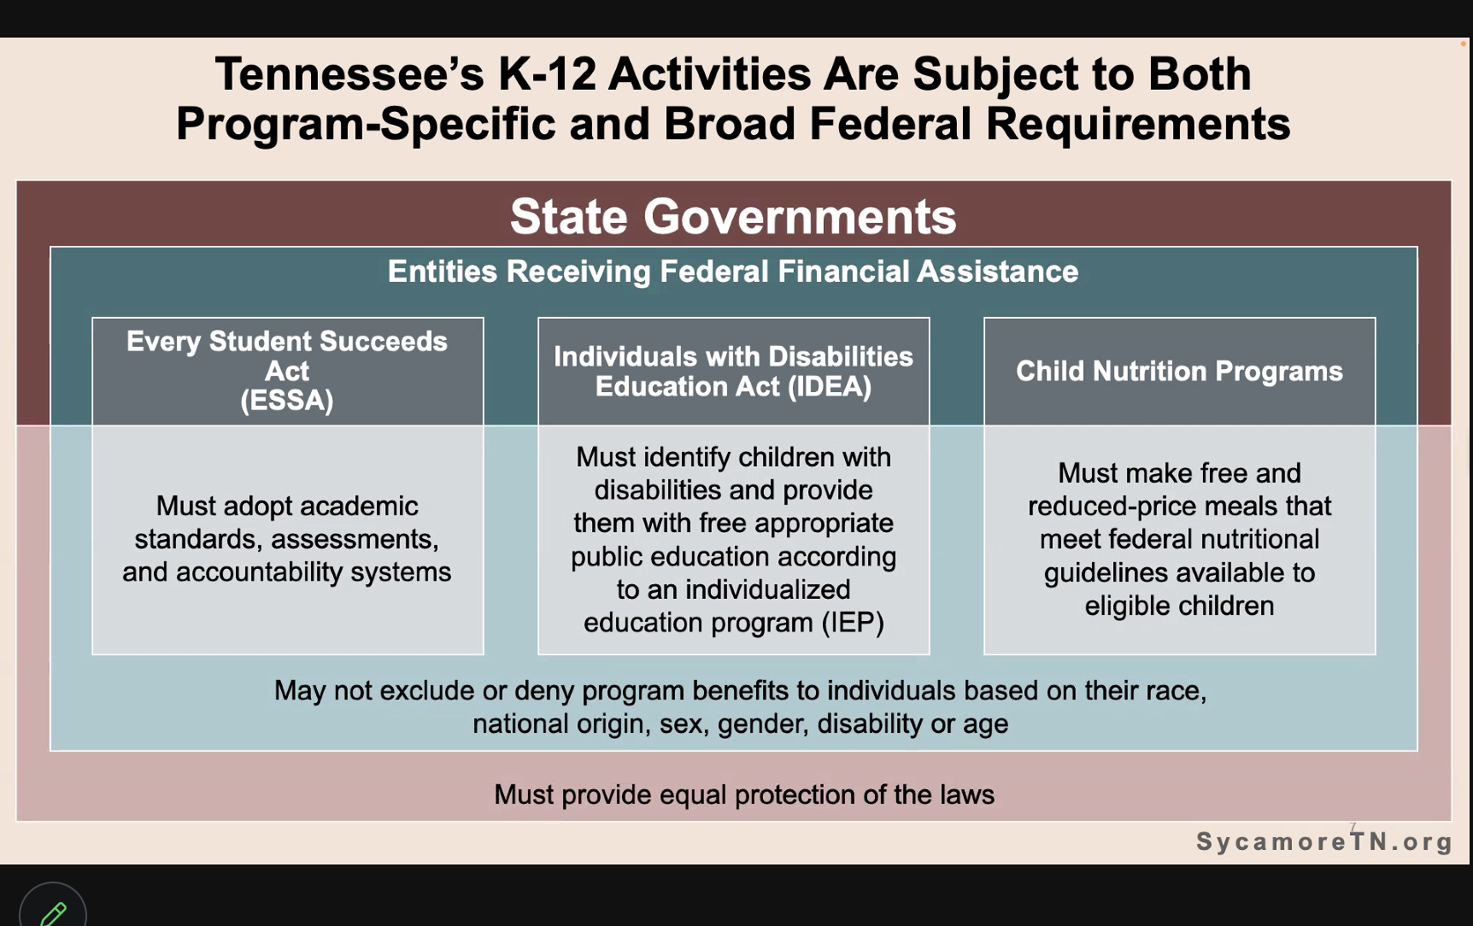
Context: Federalism Overview (2)

Slide 11
Context - federalism overview (3)
Things the federal government does not control through federalism/federal funding (in this case):
State, district or classroom choices about curriculum
Reading materials available to students
Hiring and firing of teachers
School choices issues (charter schools, vouchers, ESA’s, etc.)
Other state-level testing
What teachers can/can’t say in the classroom
State levels of funding or how they choose to distribute funds (TISA)
School sports (except for discrimination in participation)
In other words, some advocates will try to make the funding refusal issue about these issues - any assertion to the above is not true

Slide 12
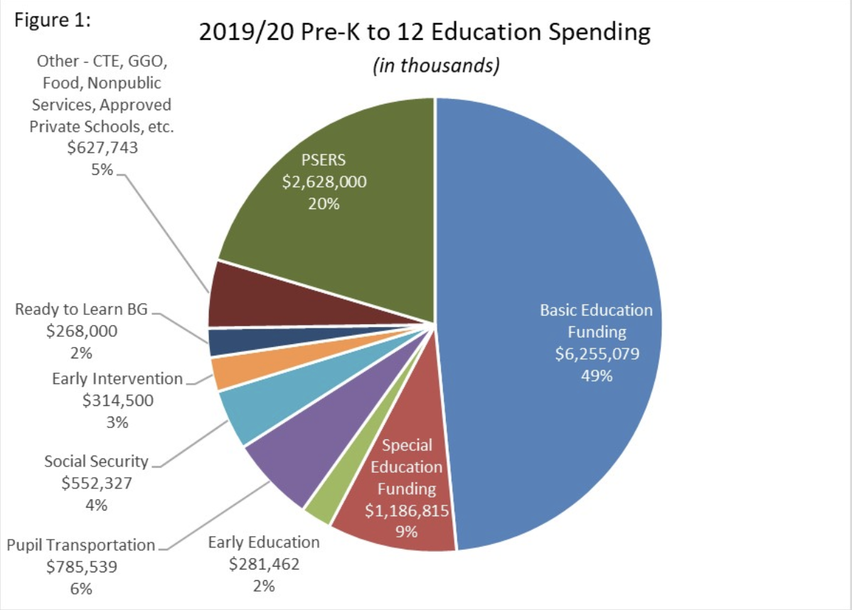
Context - federal education funding overview:
In Tennessee:
2019 - $1.1 billion
2023 (proposed) - $1.89 billion
All of this is subject to change in forgoing federal funding

Slide 13
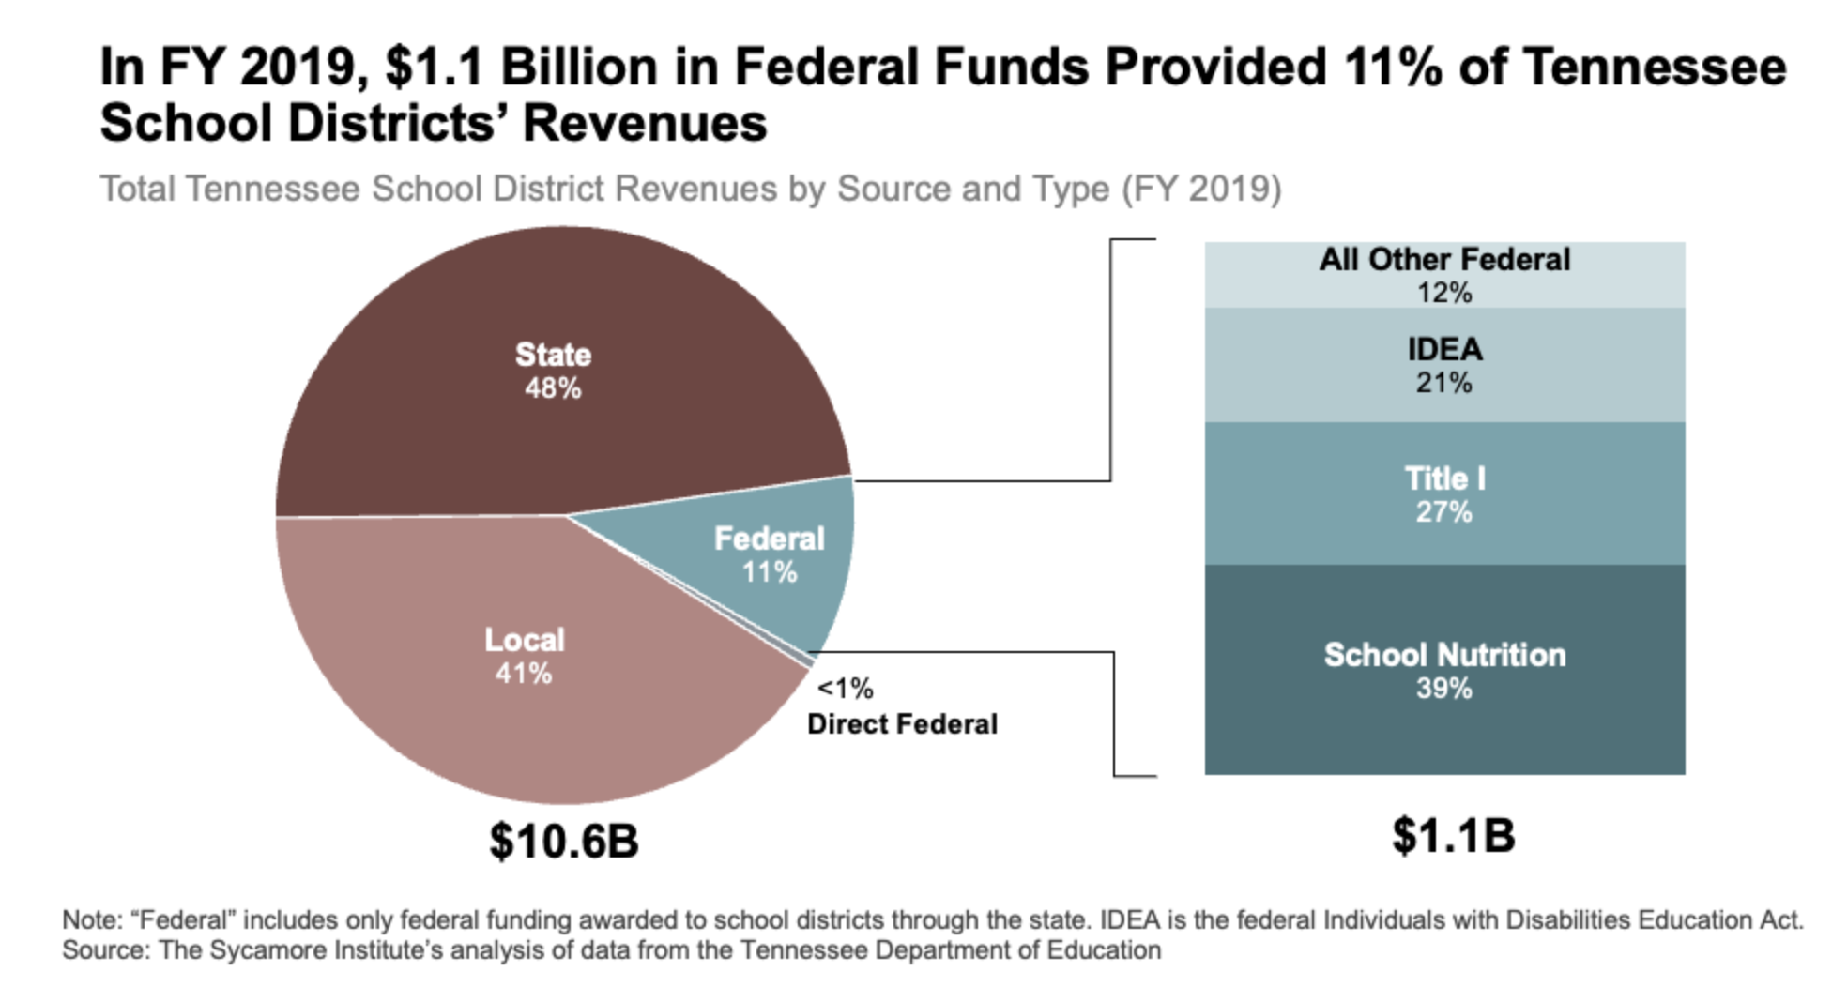
Context - what it looks like when it gets here:

Slide 14
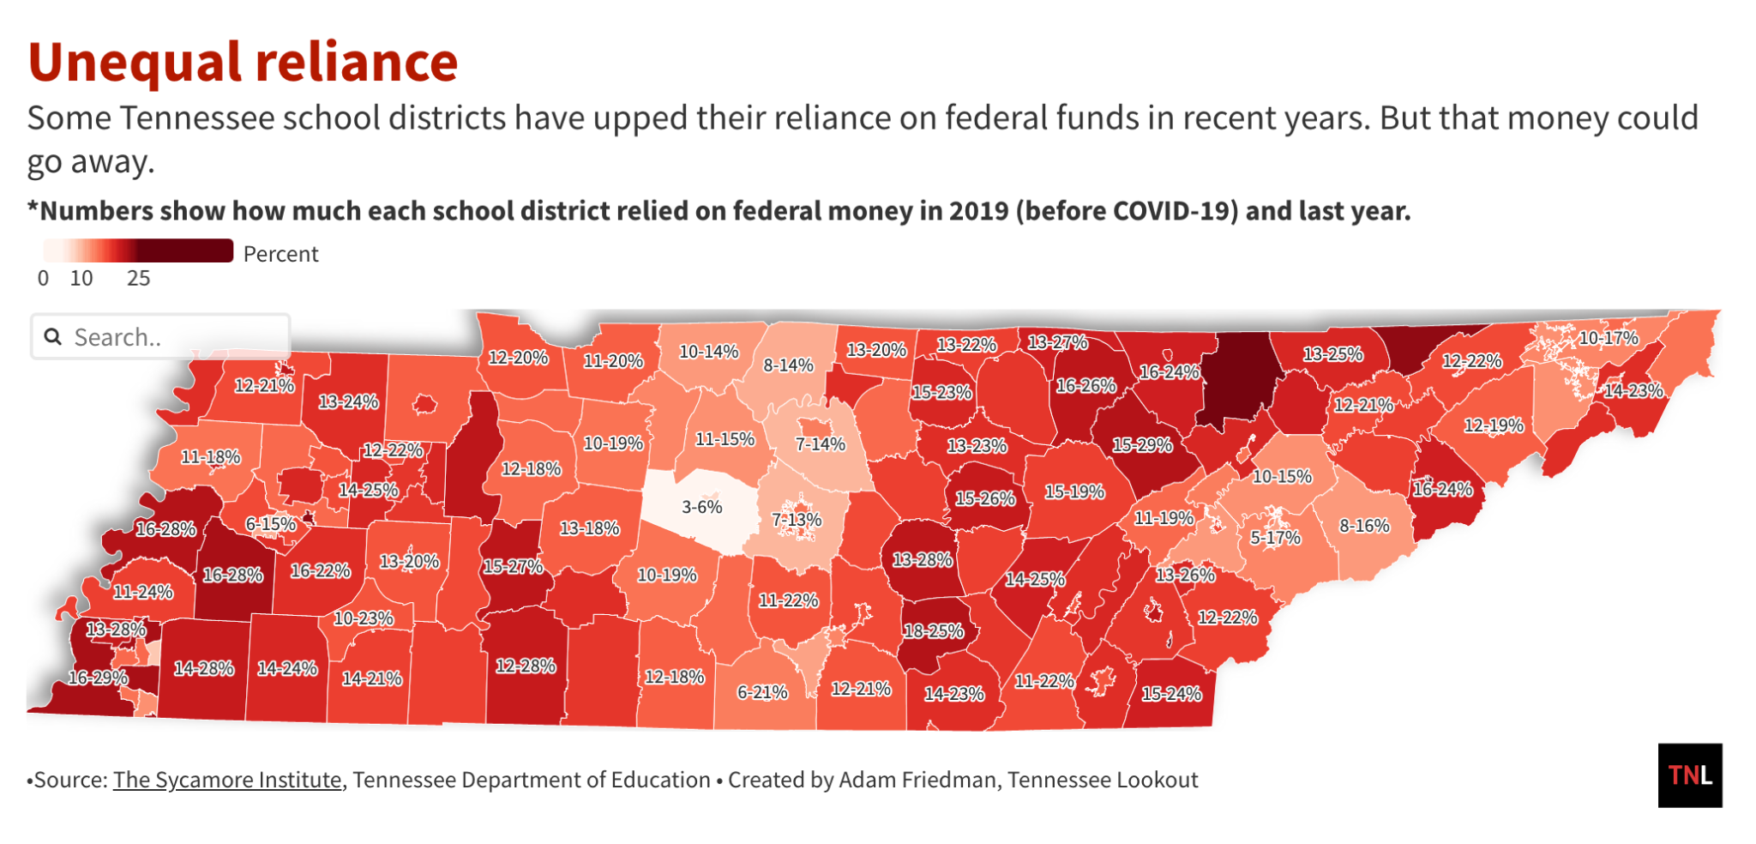
Context - how much each district gets from the feds:

Slide 15
Context - 21% of federal funds go to IDEA
Where did IDEA come from?
AKA - The Individuals with Disabilities Education Act (IDEA)
Passed in 1975 as the Education for All Handicapped Children (EHA)
Reauthorized as IDEA in 1990
Reauthorized again in 2004 to align with “No Child Left Behind” (New DOE Commish Lizzette Gonzalez Reynolds’ brainchild)
What happened before EHA/IDEA?
Most children with disabilities were “educated” at institutions or in parental educational cooperatives
Public schools served only 1 in 5 children with disabilities
Many children with disabilities were specifically and legally excluded from public schools, including those who were deaf or blind, those with behavior disorders or those with intellectual disabilities
Today, more than 65% of children with disabilities in Tennessee are educated in the general education setting for more than 80% of the day

Slide 16
Context - more of IDEA
Provides for 6 “pillars” of special education (requirements for fed funds):
Free and Appropriate Public Education (FAPE)
Individualized Education Programs (IEP)
Least restrictive environment (LRE)
Appropriate evaluations
Parent and teacher involvement
Procedural Safeguards/Due Process
Interacts with Section 504 of the Vocational Rehabilitation Act of 1973 and the Americans with Disabilities Act (ADA)

Slide 17
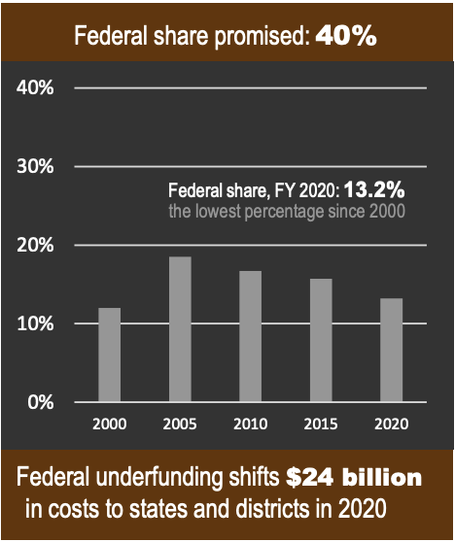
Context - even more of IDEA
Funding associated with the implementation of IDEA pays for “the excess cost of special education”:
State Department of Ed-level compliance monitoring
Special education teachers
Paraprofessionals
Other licensed related service providers (OT/PT, SLPs, school psychologists, BCBA’s, etc.)
Assistive technology devices
Alternative and supplementary curriculums
Small class sizes
Due process enforcement
IDEA itself is underfunded by the Feds
Full funding would provide an additional $429.2 million to Tennessee for SPED

Slide 18
What would happen to IDEA if Tennessee rejected federal funding?
It’s impossible to know for sure
BUT, the state would no longer be obligated by the Federal Government to provide special education services in line with IDEA
The state DOES have IEP’s/eval, LRE and FAPE rights already in the state code
The code is missing parent/teacher involvement and due process/procedural safeguards
HOWEVER, the state would then be the only party monitoring and enforcing the existing SPED provisions and rights found in the state code
And they could change them at any time for any reason if they wanted to
Probably lawsuits
Very likely chaos

Slide 19
So here is the plan:
Short term: Hold your fire until there is something to shoot at
Don’t get out ahead of what’s been said or proposed
Reiterate 3 things:
This is concerning
IDEA and Special Education are very important
We look forward to educating the Joint Working Group
Cautious contact
Long term: If/when the Joint Working Group proposes a “plan”, we have options:
Committee testimony
Meet your legislators
Media
Protest/demonstrations
Email campaign
Lawsuits

Slide 20
The plan, continued:
However, it is vitally important that the disability community is on the same page
They will try to divide and conquer
There is no compromise on any future proposal
They will offer to codify IDEA
They will say that they can refuse all funding except IDEA
We won’t accept State Board of Education rulemaking
We MUST make this about disability and disability only
There are others who can make the financial/Title 1/ESL/culture wars/this is silly arguments
Don’t let them distract us
Stay the course
It’s going to be a long battle - stick to the plan
Stay behind our skis

Slide 21
The plan, talking points (draft):
Merely “asking the question” has thrown the already hectic lives of Tennessee children with disabilities and their families into turmoil
There are no strings, aka minimum standards, that would justify functionally destroying special education in Tennessee
“These are civil rights, not strings” - the civil rights of kids with disabilities are not burdensome strings
IDEA is the bare minimum of protections of students with disabilities, students with disabilities, we don’t believe the state can do equal or better
Asking Tennessee to hold itself accountable for special education is like asking the fox to guard the henhouse
There is a powerful motivation for the state to limit expensive services and rule on its own behalf in disputes and the only one holding it to account is itself

Slide 22
The frame
Talk about:
Why special ed and IDEA are important
What is missing from the TN Code and what that means (especially oversight)
What happened before IDEA - “rolling back 50 years of progress”
What it would mean for you and your family
Just asking the question causes chaos
The apparent lack of concern for families of kids with disabilities
Don’t talk about:
The finance stuff - others can do that
How silly all of this is
Book bans, defunding public schools, bathroom bills, etc.
Ad hominem insults
School lunches, administrative overhead, etc. (the stuff they want to talk about)
Compromises

Slide 23
What you can do now:
Stay informed
tndisability.org
Other disability organizations
Read everything
Talk to your friends and neighbors
Let them know that this is a disability issue and it affects you and your family
Talk to your legislators
Remember the talking points! Concern-importance-collaboration
Use our Voter Voice message system - LINK
Look to the long term
What will happen if…
Set aside some time in the future (if you can) for in-person advocacy

Slide 24
Takeaways
There is a lot we don’t know
Keep every arrow in the quiver - bide your time
3 things (for now) - concern/importance/education
Know that when the time comes, we’ll be ready
We have options
We will need people to advocate on behalf of SPED in order to save it

Slide 25
Questions
Stay involved:
Text TEAMWORK to 72690 to stay up to date on special education in Tennessee
Sign up for policy updates at tndisability.org
Stay engaged in TDC advocacy, how you can be involved LINK or scan →
Send a message to you the working group - Voter Voice LINK

