Slide 1
Navigating the Katie Beckett & ECF CHOICES Programs - updates & resources
Presented By:
Carol Westlake(Senior Advisor) & Mandeep Kaur (Family Advocate)
Family Voices Conference
June 27, 2026

Slide 2
Get to Know Medicaid!
TennCare is Medicaid in TN - a joint federal/state program
TennCare is a Managed Care Program - uses MCOs
Medicaid is the single largest provider of health insurance and additional supports for adults and children with disabilities.
Long-Term Services and Supports (LTSS) and are designed to help people remain at home and in their communities whenever possible.
Katie Beckett and ECF CHOICES are Medicaid Waivers.

Slide 3
The Katie Beckett Waiver

Slide 4
What is Katie Beckett?
It is a TennCare funded program for children under age 18 with disabilities or complex medical needs who are not eligible for regular TennCare.
Part A provides Medicaid coverage and additional supports for children who meet institutional level of care criteria.
Part B offers a capped annual reimbursement to help families with disability-related expenses for children who are at risk of institutional care.

Slide 5
Katie Beckett and TennCare
Katie Beckett is also part of TennCare (Medicaid).
It allows certain children with disabilities or complex medical needs to access Medicaid regardless of their parents' income.
Families must first apply for TennCare as part of the process.
Katie Beckett and ECF CHOICES serve different purposes, and eligibility requirements vary.
Katie Beckett isn't a separate insurance program—it's another pathway to Medicaid for eligible children. Families should know that applying for TennCare is an important first step.

Slide 6
ECF CHOICES
Employment and Community First (ECF) CHOICES is Tennessee's Medicaid waiver program that provides home and community-based services and supports for people with intellectual and developmental disabilities of all ages. Different benefits based on needs and group.
Group 4 – Children and adults living in home.
Group 5 – Adults with more needs, includes residential services.
Group 6 – “Comprehensive Supports” for Adults
Group 7 – children and young adults with significant behavioral needs
Group 8 – Adults with significant behavioral needs leaving an institutional setting for the community

Slide 7
Understanding Waivers
ECF CHOICES provides Long-Term Services and Supports through a Medicaid waiver.
A waiver means Medicaid has permission to provide services at home and in the community instead of in institutions.
Services may include:
Personal assistance
Respite care
Community participation supports
Employment supports
Behavioral supports

Slide 8
The Role of the Managed Care Organization (MCO)
TennCare contracts with Managed Care Organizations (MCOs) to provide care and services.Your MCO is the first point of contact when you have questions about covered services or need help navigating the system.
The three MCOs in Tennessee are:
BlueCare Tennessee
UnitedHealthcare Community Plan
Wellpoint Tennessee

Slide 9
Every Family's Journey is Different
There Is No One-Size-Fits-All Answer
Every person's needs and circumstances are unique.
Eligibility for programs and services depends on financial, medical and other factors .
Available resources and providers vary by factors
What works for one family may not be the right fit for another.

Slide 10
Katie Beckett by the Numbers
Current Program Updates
Part A
Current Enrolled : 287
On the waitlist: 46
Part B
Current enrollment: 4,680
On the waitlist: 1,200
No New slots are added this year.
These numbers may change as people enroll and transition off the waitlist.

Slide 11
ECF CHOICES
Current Program Updates
Number of people enrolled: 6,405
Number of people on the waitlist: 1,770
The new state budget includes funding for 2,500 additional slots in ECF.

Slide 12
How Do People Come Off the Waitlist?
People may move off the waitlist when:
A child ages out of the program, creating an available slot
An individual's medical or financial eligibility changes
An individual is disenrolled
No new KB slots have been added to the state budget this year. In most cases, families move off the waitlist only when an existing slot becomes available.
For KB Part A, movement from the waitlist is based on severity of need. For KB Part B, the wait list operates on a first-come, first-served basis.
ECF - Enrollment is based on a priority circumstances.

Slide 13
Current Challenges Families Are Reporting
Long waitlists
Understanding eligibility decisions
Redeterminations
Navigating reimbursement processes
Confusion about policies and guidance
Limited provider availability
Staffing shortages
Communication barriers

Slide 14
Family Voices of Tennessee
Family Voices of Tennessee helps support families by creating simple, easy-to-understand language and resources to help families better understand complex processes and navigate systems with confidence.
We educate.
We organize.
We listen to families.
We identify systemic issues.
We work for policy change.
We elevate family voices.
We partner with families in advocacy.

Slide 15
Who Are the Helpers?
Your team may include:
Family Voices of Tennessee
Support Coordinators
Care Coordinators
TennCare representatives
DDA representatives
MCO representatives
Tennessee Disability Coalition
Parent mentors
Other families with lived experience
Other organizations
Together, we are stronger.

Slide 16
When You Need Help-
Escalation Pathway
Contact your assigned case manager or support coordinator.
Request supervisor involvement.
Contact DDA/TennCare program contact list.
Reach out to Family Voices of Tennessee.
Utilize grievance or appeal processes when appropriate.
Seek support from advocacy organizations.
Knowing where to turn can make a difference.

Slide 17
How to Learn More -
Stay connected through:
Family Voices of Tennessee resources
Facebook support groups
Educational webinars
Community events
Quarterly Advisory Council Calls
Family trainings and workshops
The more informed you are, the stronger your advocacy becomes.

Slide 18
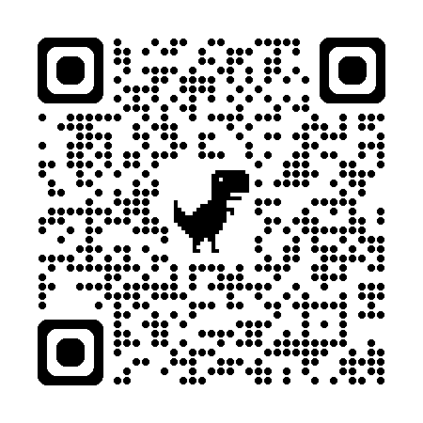
Get Connected
Go to our website FamilyVoicesTN.org
Go to “get connected”
Complete the brief referral form

Slide 19


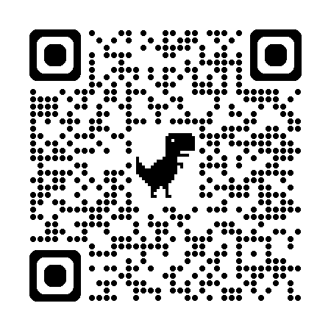
Katie Beckett Community of Support

Slide 20
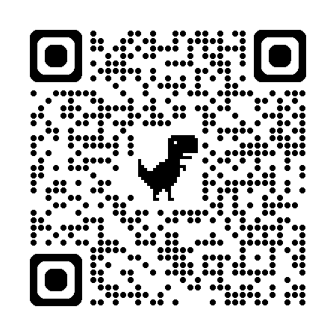
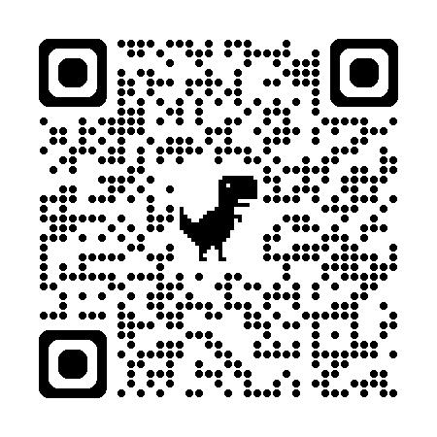
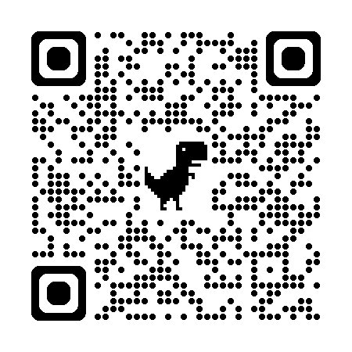
Where Can Families Find Support?
ECF East TN Group
ECF Middle TN Group
ECF West TN Group

Slide 21
Thank You

