Slide 1


Serving On
Groups
Tonya Bowman & Chrissy Hood

Slide 2
Everybody can be great
because everybody can serve.
Dr. Martin Luther King, Jr.

Slide 3
Benefits of Serving on Groups
For Families
Awareness & input on policies
Feeling of ownership
Shared experiences & connections with professionals & other families.
For Professionals
Awareness of family perspectives
Increased confidence & ability to partner with families
Acceptance of family representatives in leadership roles

Slide 4
Opportunities to Get Involved
Questions
How can I get involved
How can I share in decision-making
Who can serve on these groups
How do I get involved?
Steps
Self reflection
Awareness of possibilities
Options to explore

Slide 5
Types of Groups
Planning
Evaluation
Practice/Peer Groups
Governing
Advisory
Leadership

Slide 6
Tips
Keep in mind the groups goals
List priorities
Ask the leader to explain member roles
Check in with organizations on an ongoing basis
Take notes

Slide 7
Remember
Remember to let the group know if you need accommodations
Read things before you sign them
Ask questions
Bring your true authentic self to meetings
Each group has their own culture

Slide 8

Questions?

Slide 9
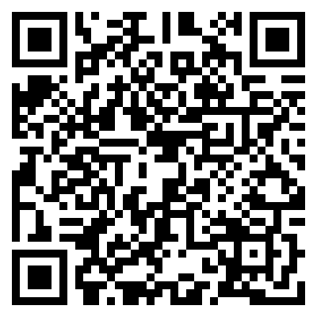
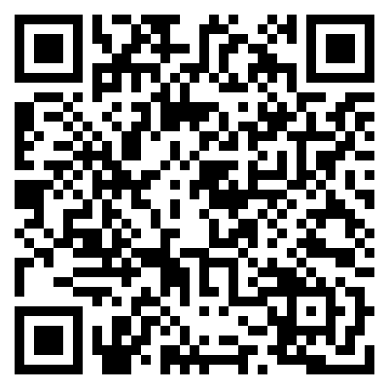
Survey
Family/Self Advocate
Professional
https://form.jotform.com/220375157093152
https://form.jotform.com/220374738942159

