Slide 1

Sharing Your Tennessee Story
Standing Out in the Current Advocacy Landscape

Slide 2
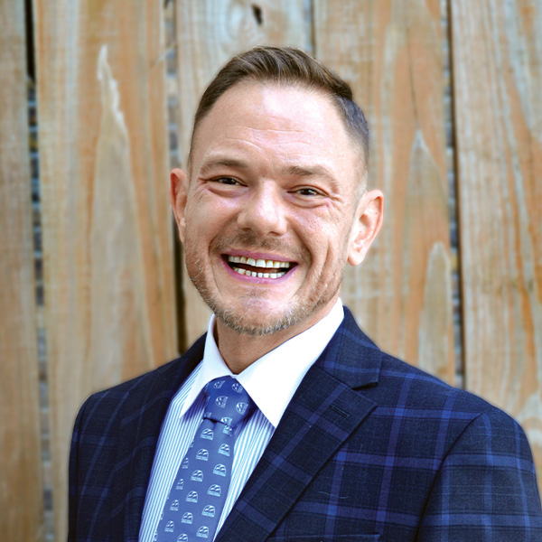
Tom Jedlowski
Director of Communications & Technology
Tennessee Disability Coalition
Nashville, TN

Slide 3
What We'll Cover Today:
The Current Advocacy Landscape of Tennessee
Why Stories Work
In-Person Meetings
Virtual Meetings
Print Media & Letters to the Editor
Social Media & Online

Slide 4
By the End of this Session You’ll Know:
What Tennesseans think of our work.
Why sharing our stories work.
How to use stories to influence the people that affect –
  You
  Your organization
  The Tennesseans we serve

Slide 5
The Landscape
What Tennesseans think about our work, and why it matters when sharing our stories.

Slide 6
Survey Says: The Public Understands Our Role
Most national survey respondents accept the contributions we make to society and our local communities.
Providing support not available through public services
Supporting the most vulnerable and responding in times of crisis
Relying on local volunteers – neighbors who step up
National Council of Nonprofits National Survey, April 2025

Slide 7
Survey Says: TN Nonprofits Are Working Against The Tide
66%
of Tennessee respondents believe most nonprofits waste taxpayer funds.
78-81%
of Tennessee respondents DO believe nonprofits serving veterans, youth & food assistance are effective
National Council of Nonprofits National Survey, April 2025

Slide 8
Focus Group Findings: TN Nonprofit Leaders & Language Fatigue
In Tennessee, terms like “nonprofit” itself have often become polarizing or confusing. Many organizations are rethinking how they describe themselves.
Some communities hear “nonprofit” and think “charity.”
  IMPLICATION: Need, inefficiency, and voluntary labor.
Others hear it and think “political” or “biased.”
  IMPLICATION: In the current climate, this can be enough to end the conversation before it starts.

Slide 9
Neutral Terms Work Best
Nonprofit Organization Community Benefits Organizations, Community Service Provider
Equity Opportunity, Equal Access
Diversity/DEI Belonging, Culture
Advocacy Education, Community Engagement, Civic Involvement
Underserved Vulnerable

Slide 10
Regional Context in Focus: What Resonates Locally
West TN: Emphasize credibility and trust. Engage faith-based networks. Prefers hyper-local voices.
Middle TN: Emphasize professionalism, strategic partnerships, and measurable impact.
Northeast TN: Address skepticism by using “essential infrastructure” framing. Use real-life examples of people helped in your community.
Southeast TN: Promote collective impact and cross-sector collaboration. Emphasize outcomes and impact.
Rural TN: Emphasize essential local services, neighborly trust, and faith/family values. Keep messaging accessible.

Slide 11
Framing That Works Across Tennessee
Essential infrastructure, not charity.
  “Strong nonprofits build strong communities. Behind every local solution, there’s a nonprofit making it happen.”
2. What if we weren’t here?
  Ask audiences to imagine their community without your organization. Make the void concrete and local.
3. Economic & workforce impact.
  Nonprofits create jobs, stimulate local economies, and provide services no one else will.

Slide 12
The Stories We Tell: What Works

Slide 13
“Facts and data don’t move people. Stories do.” – TN State Sen. Bo Watson, R-Hixson
People remember stories 22 times more than facts alone (Stanford research).
Legislators are voters' representatives — a constituent's real experience carries enormous weight.
Your story is unique. Your organization’s story is unique. No one else can tell it, and no one can argue with your lived experience.

Slide 14
The Elements of a Compelling Advocacy Story
THE STAKES:
What's at risk? What does this policy mean for your daily life, your child's future, or your organization?
THE MOMENT:
Describe one specific, concrete experience — not a general summary. A single moment is more powerful than a list.
THE ASK:
What do you want the listener to do? Be specific: co-sponsor this bill, vote yes, schedule a meeting.
THE CONNECTION:
Show how your story connects to others — you're not alone, and the issue affects many Tennesseans.

Slide 15
In-Person Meetings with Your Legislator:
Walking into a legislators office can be intimidating. It shouldn’t.
When it comes to your own life, or your organization, and the people you serve, you are the expert in that meeting - and the realities of your life are exactly what they need to hear.

Slide 16
In Person Meetings with Your Legislator: Prepare
Find your legislators at capitol.tn.gov
Research their committees — target relevant chairs
You can meet with legislators outside your district

Slide 17
In-Person Meetings with Your Legislator: During
Introduce Yourself: Your name, your city, and one sentence on why you’re here.
Tell Your/Your Org’s Story: One specific experience. Real. Human. Yours.
Connect to Policy: Briefly explain how a bill, a policy, or budget decision affects people like you.
Make Your Ask: One clear, specific request. Vote yes. Co-sponsor this bill. Change this policy.
Say Thank You: Thank staff too — they brief the legislator before and after.

Slide 18
In-Person Meetings with Your Legislator: After
Include a Photo: A printed photo from your visit — with the legislator, at the capitol, or with your group — puts a face on your story. Staff genuinely appreciate these, and they often end up on office walls.
Add a Handwritten Note: Even one or two sentences in your own handwriting signals this isn't a form letter. It came from you. That distinction matters enormously in a sea of emails and printed petitions.

Slide 19
In-Person Meetings with Your Legislator: After
A photo + handwritten note is rare, human, and hard to forget.
Do this every time.

Slide 20
Virtual Meetings with Your Legislator:
Virtual meetings are just as effective when you show up prepared.
And they remove barriers — no travel, no parking, no missing work.

Slide 21
Virtual Meetings with Your Legislator: Before
Test your camera, mic, and speakers 10 minutes early
Sit with light in front of you, not behind
Dress business-casual — what you'd wear in person
Keep a phone nearby as a backup dial-in
A clean or neutral background keeps focus on you

Slide 22
Virtual Meetings with Your Legislator: During
Introduce Yourself: Your name, your city, and one sentence on why you’re here.
Tell Your Story: One specific experience. Real. Human. Yours.
Connect to Policy: Briefly explain how a bill, a policy, or budget decision affects people like you.
Make Your Ask: One clear, specific request. Vote yes. Co-sponsor. Schedule a follow-up.
Say Thank You: Thank staff too — they brief the legislator before and after.

Slide 23
Virtual Meetings with Your Legislator: After
Send a Thank You: Mail a written note within 48 hours with your photo and a handwritten line or two. Physical mail stands out when most follow-ups are emails.
Stay Connected: Follow your legislator on social media. Engage when they post on relevant topics. Relationships are built over time, not in a single call.

Slide 24
Virtual Meetings with Your Legislator: After
A photo + handwritten note is rare, human, and hard to forget. Do this every time.

Slide 25
Virtual Meetings with Your Legislator: After
Tag Them Publicly: Post on social media thanking your legislator for their time. Many have staff who monitor mentions on socials. Public acknowledgment reinforces the relationship.
Share With Your Network: Tell other advocates what you learned. Your experience helps others prepare for their own meetings and builds collective power.

Slide 26
Engaging the Media: Print Newspapers & Social Media
Print Media: e.g. The Tennessean, Chattanooga Times Free Press, Johnson City Press, Commercial Appeal
Social Media: e.g. Facebook, Instagram, X (Formerly Twitter)

Slide 27
Print Newspapers: Letters to the Editor
Letters to the editor remain among the most-read sections of any newspaper.
Tennessee legislators pay close attention to them — they're a direct signal of constituent opinion in a politician's home district.

Slide 28
Print Newspapers: Letters to the Editor
Keep it under 250 words — editors enforce limits strictly
Lead with your most important point
Use your real name and city — anonymous letters carry less weight and are almost never printed
Try to reference a recent story, bill, or vote to increase odds of publication
Submit online; check each paper's submission guidelines first

Slide 29
Print Newspapers: Letters to the Editor
Coordinate for Greater Impact!
  One letter is good. Ten letters on the same topic on the same week is a movement.
  Editors typically publish a representative selection of the letters they receive. The more submissions that support a particular idea, the more likely it gets covered — even unpublished letters influence which ones make the cut.

Slide 30
Print Newspapers: Letters to the Editor
  Coordinate for Greater Impact!
    Coordinate with families, advocates, and partner organizations
    Submit letters timed to a relevant news event, legislative session, or vote
    Vary the writers and angles — editors want a range of voices on a single issue, not a copy-paste
    Share published pieces with legislators, their staff, and your own networks
    Mail physical clippings to your legislators with a handwritten note

Slide 31
Engaging the Media: Social Media & Reaching Thousands Right From Your Phone
The modern advocacy landscape is social.
You don't need a big following — you need the right people to see your story.

Slide 32
Engaging the Media: Social Media & Reaching Thousands Right From Your Phone
Facebook – Reach families, community groups, and local news pages. Best for longer posts and photo albums. Tag your legislators — their pages are public.
X (Twitter) – Ideal for quick reactions to legislative news. Tag @TNSenate, @TNHouseGOP, or your specific legislator. Hashtags like #TNLeg connect you to the statewide conversation.

Slide 33
Engaging the Media: Social Media & Reaching Thousands Right From Your Phone
Instagram – Photo + caption format is perfect for personal stories. A strong photo with 3–5 sentences can reach far beyond your followers through shares and hashtags.
TikTok– Short personal videos are among the most shareable content online. You don't need production value — authenticity is the point.

Slide 34
Social Media & Reaching Thousands Right From Your Phone: What Actually Works
Do’s & Don’ts

Slide 35
DOs –
Start with a human moment, not a statistic
Use a photo — every time you can
Be specific: names, places, dates
End with a clear call to action/thank you and openness to meet again
Tag your legislators' official accounts
Use 2–3 relevant hashtags (#TNLeg, #DisabilityRights)
Share in relevant groups and communities

Slide 36
DON’Ts –
Open with jargon or acronyms
Posts with no image or explanation
Vague statements
Only posting once and moving on
Long paragraphs — break them up
Don’t know? Don’t assume. Offer to get back to them.
Arguing in comments — redirect to private message

Slide 37
Above all, remember:
Small, consistent connections build the
relationships that change policy.

Slide 38
Call for Scorecard Stories

Slide 39
Thank you!

