Slide 1

The Community Integration Mandate
October 6th, 2026

Slide 2

Housekeeping
•Turn captions on
•Take care of yourself
• We will take questions at the end
Please keep the chat to a minimum – it is disruptive for anyone using a screen reader.

Slide 3
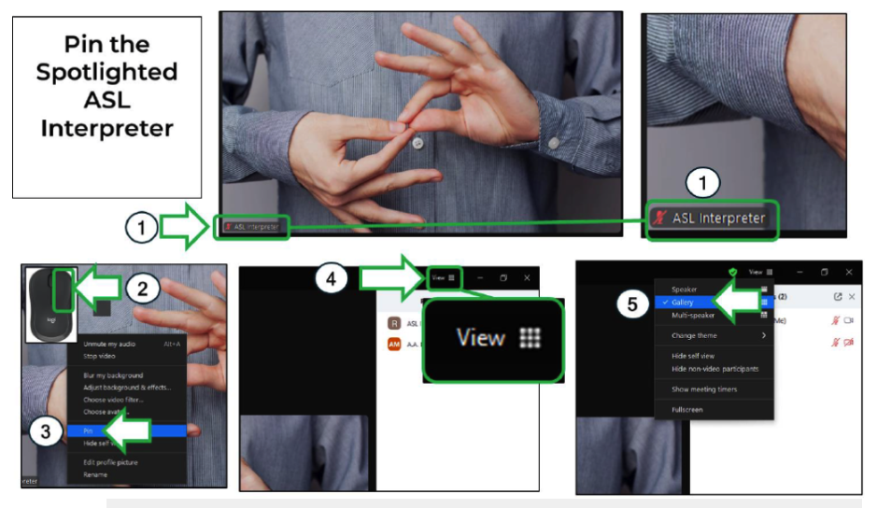
Pin the ASL Interpreter
Notes:
https://aa-intergroup.org/documents/zoom-how-to-information/

Slide 4
Introductions
Speakers:
Carrie Carlson, Director of Community Engagement
Justine Hrvatin, Director of Public Policy
Sarah Sampson, Executive Director

Slide 5
Agenda
Carrie - Community Integration Mandate - Past
Justine - DOJ Memos, Texas v. Kennedy, Bipartisan House Resolution - Present
Sarah - Disability Advocate Response, AAPD, other states, family concern - Future

Slide 6
Past
What is Community Integration
Why is it important
Where it all started

Slide 7
What does community integration mean?
Community integration for people with disabilities means living, working, and taking part in everyday community life side by side with people who do not have disabilities - DREDF

Slide 8
Where the Integration Mandate all Started
Been the law since 1977 (almost 50 years)
First appeared in Health and Human Services (HHS) Department, Section 504 regulation for grantees.
1990 after the ADA was passed, it was written in the Title II (State and Local Gov’t)
the Integration Mandate is in the laws and the statutes of Section 504 & the ADA.

Slide 9
The Integration Mandate
Both the Americans with Disabilities Act (ADA) and Section 504 of the Rehabilitation Act contain integration mandates:
Bans the unnecessary segregation of people with disabilities
State and local governments that provide services to people with disabilities, must offer those services in people’s homes and communities – not just in institutions ~ ADA

Slide 10
Key Principles
Prohibition of Segregation: Unjustified institutionalization or isolation of individuals with disabilities is considered a form of unlawful discrimination.
The Olmstead Standard: Community-based placement is required if it is appropriate for the individual's needs, the individual does not oppose it, and it can be reasonably accommodated using available state resources.
Access to Services: Individuals have a right to home and Community Living and Olmstead support systems that enable them to live and work as independently as possible.

Slide 11
Segregated Settings
Places where people with disabilities live, work, or spend most of their time with other people with disabilities, other than non-disabled paid staff. These settings:
tend to limit a person’s ability to go out in the community and mainly offer group activities and community outings;
lack privacy; limit when or how often a person can have visitors; or
have a lot of rules, like about when a person can eat, bathe, groom, get dressed, or go out.
Examples include mental health facilities, nursing homes, and intermediate care facilities.

Slide 12
Community-based Services
Nursing services - nurse who comes to your house for ventilator or tracheostomy care
Personal care services/DSP’s - ADLs (activities of daily living) bathing/dressing
Mental health services - counseling or ACT (Assertive Community Treatment)
Medication management - help taking medicine or reminders to take medicine
Peer mentorship - help from a person with lived experience who can model and support self-advocacy
Caregiver supports - mentorship, training, and respite
Home modifications - installing a ramp or widening a door
Housing services - help finding, moving, and remaining in community-based housing
Funded by federal, state, and local dollars!

Slide 13
Olmstead Started with Two Women
Both women:
Had intellectual disabilities and mental health disabilities
Were living in institutions
Confined to a Georgia State Psychiatric hospital for months, and sometimes years after they had been cleared for discharge.

Slide 14

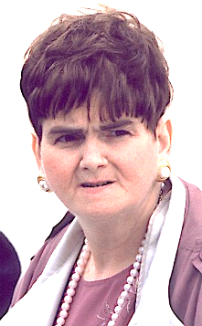
The Ladies of Olmstead
Lois Curtis
Elaine Wilson
Notes:
Lois Curtis was institutionalized at the age of 11. She spent 20 years in and out of various state-run psychiatric hospitals and institutional settings, primarily confined at Georgia Regional Hospital. Her treatment team eventually agreed that she was capable of living independently, but the state of Georgia refused to fund community-based support. [1, 2, 3]Lois spent her years after Olmstead living independently in her chosen community. She was an artist whose artwork has hung in the White House and in galleries around the country. In 2011, to celebrate the Olmstead Decision anniversary, Lois presented President Obama with a self-portrait of herself as a young girl, part of a series she did because she had no photos from her childhood in state institutions. https://www.womenshistory.org/education-resources/biographies/lois-curtis
Elaine Wilson was born and raised in Georgia.
Age 6 (Initial Illness): At six years old, she was hospitalized with a severe, protracted high fever. This illness caused the permanent brain damage and developmental delays that shaped her life.
Age 15 (First Institutionalization): At 15 years old, she was enrolled by her mother in her first long-term facility, Gracewood State School and Hospital in Augusta, Georgia, following a diagnosis of intellectual disability.
1990 Admission (Olmstead Case Baseline): She voluntarily admitted herself to the psychiatric unit at the Georgia Regional Hospital in Atlanta, which ultimately became the focal point of the landmark Olmstead v. L.C.* disability rights lawsuit.
In 1999, at Age 48 (Supreme Court Ruling): By the time her historic case was decided by the U.S. Supreme Court in 1999, she was 48 years old

Slide 15
Olmstead Confirmed the Integration Mandate
Olmstead v, L.C. is a landmark Supreme Court decision.
In 1999 United States Supreme Court ruled that under the Americans with Disabilities Act (ADA), the unjustified institutionalization of people with disabilities is a form of discrimination ~ ADA

Slide 16
Department of Justice (DOJ) June 2026
June 18, 2026, DOJ's Office of Legal Counsel issued a new opinion taking a different view on Olmstead.
DOJ now argues that the ADA and Section 504 do not require states to provide services in the most integrated setting in the broad way DOJ previously interpreted them.
Notes:
In June, the Department of Justice released a new opinion that takes a narrower view of Olmstead and community integration.
Essentially, DOJ is now arguing that the ADA and Section 504 do not require states to provide services in the most integrated setting in the broad way the federal government had previously interpreted these laws.
So, this represents an important change in the federal government’s position.

Slide 17
Why is this memo important?
For years, states could violate the ADA by:
  institutionalizing people unnecessarily
  through service systems, funding decisions, waiting lists, or cuts that put people at serious risk of institutionalization
The Olmstead ruling changed this.
The new memo is a reversal of feds’ previous interpretation of Olmstead.
Notes:
Why does this memo or opinion matter?
For years, federal guidance said states could potentially violate the ADA not only by unnecessarily institutionalizing someone, but also through policies or funding decisions that put someone at serious risk of institutionalization. Federal guidance did not say that exactly but this is what the interpretation was.
The unnecessary institutionalization could be a result of things like cuts to community services, long waiting lists, or gaps in supports.
The new DOJ position pulls back from that broader interpretation.”

Slide 18
Texas v. Kennedy
What is it?
lawsuit challenging parts of the federal government’s 2024 Section 504 rules.
does not overturn Olmstead or the ADA,
What are the 2024 Section 504 rules?
Updated regulations on how the ban on disability discrimination applies to health and human services programs that receive HHS funding
In August 2026, the feds joined the states in asking the court to remove the community-integration language from those Section 504 regulations.
Notes:
At the same time, we also have Texas v. Kennedy.
This lawsuit challenges parts of the federal government’s 2024 Section 504 regulations, which strengthened disability protections in health and human services programs.
In August, the federal government joined the states in asking the court to remove the community-integration language from those regulations.
The important thing to remember is that this does not overturn Olmstead or the ADA. But it could remove some of the newer federal protections around community integration.”

Slide 19
Texas v. Kennedy Update
What happened?
On September 23, 2026, a federal judge removed parts of the 2024 Section 504 rules
What does this mean?
Section 504, the ADA, and the Olmstead Supreme Court decision are still in place. People with disabilities still have legal protections against unnecessary institutionalization.
Notes:
On September 23, a federal judge ruled in favor of removing parts of the 2024 Section 504 rules.
These rules protected community integration for people with disabilities.
What does this mean?
Section 504, the ADA, and the Olmstead Supreme Court decision are still in place. People with disabilities still have legal protections against unnecessary institutionalization.
However, the federal rules that clearly explained how these protections apply to community-based services are now gone. This may make the rules less clear and could make enforcement harder.

Slide 20
What does all this mean for Tennessee?
Can people with disabilities still bring Olmstead claims?
Yes, people with disabilities can still bring Olmstead claims. The DOJ’s June 2026 opinion or July 2026 Federal Register notice don’t erase the ADA, Section 504, or the right to challenge unnecessary institutionalization.
Watch out for Medicaid Cuts.
Notes:
As of right now, the law is good. . But if the federal government steps back from enforcement, people with disabilities and advocates may have to rely more heavily on private lawsuits, state advocacy, and disability rights organizations to protect these rights.
The bigger concern is what happens if the federal government becomes less involved in enforcing these protections.
And this is especially important to watch as Tennessee also faces potential pressure from future Medicaid funding cuts, because Medicaid helps fund many of the services that allow people to live in the community. The medicaid cuts that were passed in 2025 could cause some difficult decisions to be made when providing services due to this change.

Slide 21
Public services in Tennessee law supports community-based services.
Long-term supports and services (LTSS)
CHOICES
Employment and Community First (ECF) Choices
Katie Beckett
OPTIONS for Community Living
Family Support Program
Notes:
So Carrie. Already showed a list of overall community-based services and Tennessee has several of these programs that support people with disabilities in their homes and communities.
These include CHOICES, ECF CHOICES, Katie Beckett, OPTIONS for Community Living, and the Family Support Program. This is not all of them but space was limited.
So, the issue to watch is not that these programs suddenly disappear because of this federal change. The concern is how changes in federal policy, enforcement, and funding could affect community-based services over time.
For now, these rights and programs remain in place, but this is something we need to continue watching closely.

Slide 22
Community and Agency Responses
Community concerns - Self Advocates, Families, Disability Organizations and Beyond
American Association of Persons with Disabilities (AAPD) https://www.aapd.com/
Family Voices National Statement https://familyvoices.org/family-voices-response-to-the-department-of-justices-legal-opinion-memorandum/
The Arc of the United States - the DOJ opinion explained: https://thearc.org/blog/doj-opinion-on-olmstead- threatens-the-right-of-people-with-disabilities-to-live-in-the-community/
Tennessee Council on Developmental Disabilities newsletter: Jolene Sharp, Chief Strategy Officer
NAACP - one of the oldest and largest civil rights organizations in the United States that advocates for civil rights and social justice - views the landmark 1999 Supreme Court decision Olmstead v. L.C. as one of the most critical civil rights rulings in American history, frequently highlighting the deep intersection between disability rights and racial justice.

Slide 23
Resources
American Association of Persons with Disabilities (AAPD) webinar
https://youtu.be/H7AFrTff67E?si=4_OUQz9zCro9ZABX
Autistic Self Advocacy Network plain language resource
https://autisticadvocacy.org/actioncenter/issues/community/rule/
OlmsteadRights.org: plain-language information and self-advocacy tools
https://www.olmsteadrights.org/faq/
Disability Rights Tennessee: help understanding and defending your rights https://www.disabilityrightstn.org/
Tennessee Centers for Independent Living: https://www.silctn.org/

Slide 24
TN Disability Coalition Plans
Organizing members
Send a letter to TN Delegation in US Congress, Letter to TN Department of Disability & Aging Commissioner, Letter to TN Department of Mental Health and Substance Abuse Services Commissioner
Developing educational resource for the community
Call to action for the community to share about community services that matter to them with TN state legislators

Slide 25
What can you do?
Take 2 minutes. Contact your legislator.
Your story is the single most powerful tool we have. Find your state legislator’s contact
information using this link: https://wapp.capitol.tn.gov/apps/fml/search
For tips on what you could write, check out our template letter available at: www.tndisability.org
Need help or want to learn more?
Disability Rights Tennessee: help understanding and defending your rights: https://www.disabilityrightstn.org/
Tennessee Justice Center: https://www.tnjustice.org/freehelp
OlmsteadRights.org: plain-language information and self-advocacy tools: https://www.olmsteadrights.org/faq/
Tennessee Centers for Independent Living: https://www.silctn.org/

Slide 26
Questions?
If we don’t have enough time to answer your questions today, please contact Justine Hrvatin via email at: justine_h@tndisability.org or 615-383-9442

Slide 27
Thank you!

